Slide 1
Web Development
Lecture 7 - Dynamic Content

Slide 2
Reminders
Main Assignment Details posted to Moodle (top of page)
- Delivery date 15th Dec.
CA Moodle Quiz 14th Nov. Duration 1 Hour. Class continues after quiz.
Watch out for practice quiz in next week’s moodle section.

Slide 3
Dynamic vs Static Web Pages
Consider if you were to generate a full page for every single Amazon product, they would be next to impossible to manually manage
Pages would get corrupt, lost, mistagged, damaged, etc
Given that all of them look the same, and the data/content is different, we can look at the notion of a template
If we use a template, we just fill in the blanks, and alter some portions depending on what we need.

Slide 4
Header/Footer standardisation
In any set of company pages, we typically have a standard set of header and footers that are the same on all or most pages.
There can be other elements as well, not just headers and footers
They can include common side bars, images, elements for different pages
We will look at the example of headers and footers, and these can be generalised to other forms yourself

Slide 5
Page Layout
Header
Content for individual pages
Side-Bar
Footer

Slide 6
Justification for single header/footer
We are going to create a single file to hold the code for the header and a separate one for the footer
We then call these on every page that has a header and/or footer
The idea is that we only have one place to change the code if we decide to change the header or footer, rather than make changes on every page in the site
This is the same basic idea as creating functions for code reuse rather than rewriting the same code every time
Particularly useful for menus as they are generally common across an application

Slide 7
How to set this up
To do this, we need separate files for each bit of code that will be common to all files/pages. Create folder products under htdocs
For now we will create a header, footer, index page and second page
header.php
footer.php
index.php
second.php
We will use the index and second page to show the same content on both pages

Slide 8
header.php
<!DOCTYPE html>
<html>
<head>
</head>
<body>
<link rel="stylesheet" href="menu.css">
<link rel="stylesheet" href="style.css">
<ul>
<li><a href="index.php">Home</a></li>
<li><a href="createProduct.php">New</a></li>
<li><a href="products.php">List</a></li>
<li><a href="#about">About</a></li>
</ul>
We put whatever should be in every header page in here, in our case,
Stylesheets
Menu
Page title

Slide 9
menu.css
ul {
list-style-type: none;
margin: 0;
padding: 0;
overflow: hidden;
background-color: #333;}
li {
float: left;}
li a {
display: inline-block;
color: white;
text-align: center;
padding: 14px 16px;
text-decoration: none;}
li a:hover {
background-color: #111;}
Create menu.css in the same folder.
This will make the menu as a horizontal menu

Slide 10
footer.php
There is a lot more that we could have in our footer, some pages have very little, just contact info, some have a lot more links, as are appropriate for the specific business requirements
In our case, we just define a piece of text that says
© CCT College 2017
<div id=’footer’ >
<br/><br/>&copy; CCT College 2017
</div>
</body>
</html>
HTML special characters, for more see here

Slide 11
Include function
To add the header and footer to another page we can use the php
include() function.
We just pass as a parameter the file we want included on the page
This can be just a snippet of html code, like we’ve seen or php code or a mixture of both

Slide 12
index.php
<?php
include('header.php');
?>
// include the header page
<h1>Welcome To our Products App</h1>
<p>All sorts of normal content go in here</p>
<?php
include('footer.php');
?>
// include the footer page

Slide 13
secondpage.php
<?php
include('header.php');
?>
// include the header page
<h1>Second Page</h1>
<p>All sorts of normal content go in here</p>
<?php
include('footer.php');
?>
// include the footer page

Slide 14
Dynamic Page Content - List of Products
Now, we want to generate pages based on database entries
That is, for some online sites that have a large database of products, we don’t want to write a separate page for each product, rather, we want to generate the page, or fill in a template based on what comes back out of the database
Even if the number of products is quite small, we should not hardcode a list of products or hardcode the individual pages

Slide 15
Dynamic Page Content - List of Products
We’re going to create a Products application
Create - add new product to database (INSERT)
Read - read product from database (SELECT)
Update- edit existing product on database (UPDATE)
Delete- remove product from database (DELETE)

Slide 16
Let’s get set up to try this
Start your xampp server and associated MySQL Server
Open your Heidi or phpMyAdmin and create a new table:
Make sure you have selected a database first (wdtest)
CREATE TABLE Products(id INT NOT NULL AUTO_INCREMENT,
product_name VARCHAR(50) NOT NULL, product_description VARCHAR(100), cost DECIMAL(8,2),
PRIMARY KEY(id));

Slide 17
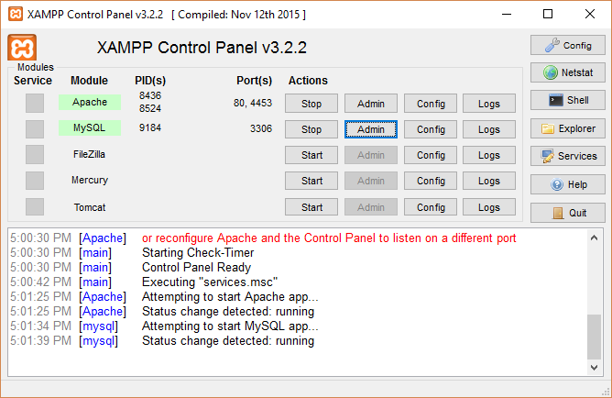
phpMyAdmin
Click Admin button
To start phpMyAdmin on xampp

Slide 18
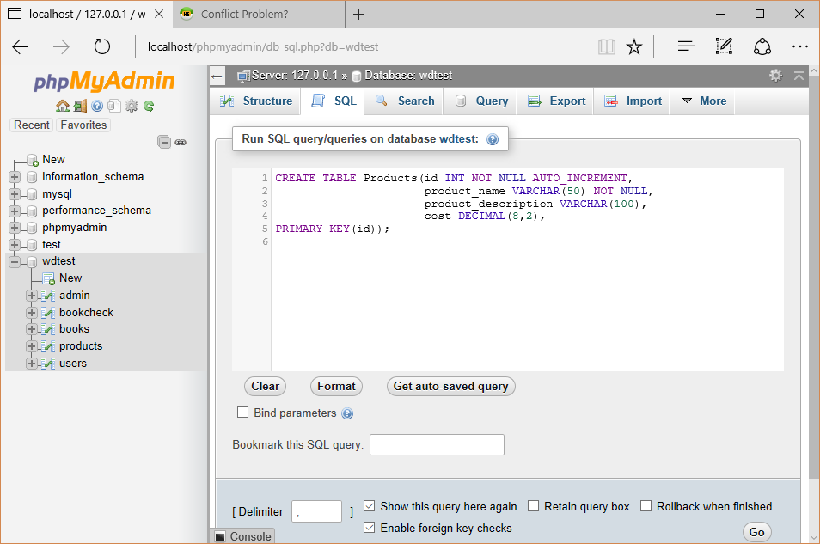
Select This tab
To Run Query

Slide 19
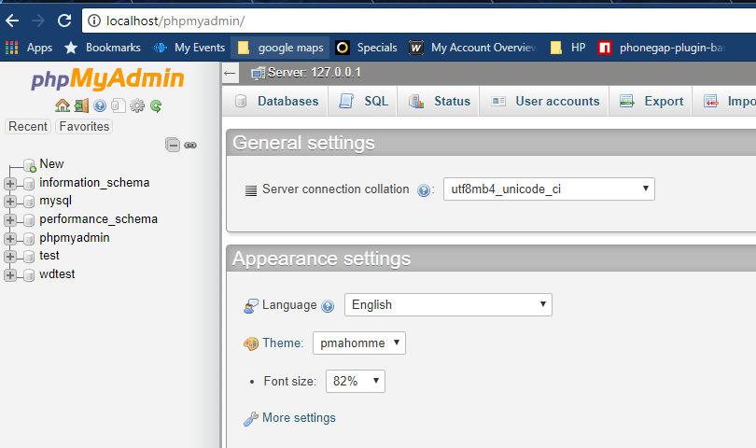
phpMyAdmin
Or via browser. localhost/phpmyadmin

Slide 20
Add some data
Now that we have a table, let’s add some data to the table
Specifically some products
Add 6 - 7 products to the table, either via SQL statement or ia the INSERT tab
Eg
1
2
3
4
5
6
7
phone tablet laptop desktop monitor mouse keyboard
Some amazing phone An even better tablet Snazzy laptop
Big fancy gaming machine 32 inch flat screen standard mouse
wireless keyboard
235.43
452.00
1234.54
2345.43
345.32
9.99
20.99
insert into products (product_name,product_description,cost)
values('pc','Laptop Lenovo',789.00);

Slide 21
Double check
Double check that the data is actually in there:
SELECT * FROM Products;

Slide 22
Products.php
First, let’s create a page that will show our list of products from the database.
Essentially,
we want to call the database
use our select statement to get the information from the database and
display this information to the page
Later we will link these list entries with the specific product pages
If you haven’t done it already. Let’s create a folder under htdocs folder called products where we will put our new files

Slide 23
db.php
Create this file and save in products folder and we will include it in all our files
<?php
try{
$host ='127.0.0.1';
$dbname = 'wdtest';
$user = 'root';
$pass = '';
$DBH = new PDO("mysql:host=$host;dbname=$dbname",$user,$pass);
}catch (PDOException $e) {echo $e->getMessage();}
?>

Slide 24
db.php
If you need to change the port number
<?php
try{
$host = '127.0.0.1';
$dbname = 'wdtest';
$user = 'root';
$pass = '';
$port=3307;
$DBH = new PDO("mysql:host=$host;dbname=$dbname;port=$port",$user,$pass);
}catch (PDOException $e) {echo $e->getMessage();}
?>

Slide 25
PDO revisited
$DBH = new PDO(“mysql:host=$host;dbname=$dbname”,$user,$pass);
$DBH is an instance of the class PDO
$DBH now has a number of functions (or methods) available to it including the prepare() function

Slide 26
PDO prepare()
Prepares an SQL statement to be executed by the PDOStatement::execute() method.
The SQL statement can contain zero or more named (:name) or question mark (?) parameter placeholders for which real values will be substituted when the statement is executed
$stmt = $DBH ->prepare("insert into users
(username, email, password)
values (?, ?, ?)");
Arrow notation allows access to function (or methods) of the instance of the class
Positional Placeholders

Slide 27
PDO Statement Class
The prepare function (or method) returns an instance of the class
PDOStatement
In the previous example $stmt is now an instance of the PDOStatement class
PDOStatement has a number of methods we can use, including
bindParam() - bind parameter to placeholder in prepare statement
execute() - execute sql statement

Slide 28
PDO Statement Class
$stmt = $DBH->prepare("select * from users where username = ?" );
$stmt->bindParam(1, $username);
$stmt->execute();
Once the sql statement has been executed we can use other functions to return data from the sql execution. Generally we are returning rows of data in an associative array, where the key is the database table column name and the value is the column data.
$stmt->fetch() - return single row from a query
$stmt->fetchAll() - return all rows in a query

Slide 29
Products.php
<?php
// create the connection
include('db.php');
// select the correct table
$stmt = $DBH->prepare("SELECT * FROM Products");
$stmt->execute();
// get the rows and put it in a variable
$rows = $stmt->fetchAll(PDO::FETCH_ASSOC);
foreach($rows as $row){
echo $row['id'].", ".$row['product_name'].", ".$row['product_description']."<br/>";
}
?>

Slide 30
errordb.php
We have been having problems with inserts not working and not getting any useful errors. To remedy this we can add the following after the ->execute() of our SQL statement
<?php
$arr = $stmt->errorInfo();
if (isset($arr[2])) {// we have an error
echo "<br/> Database Error Code: ".$arr[0];
echo "<br/> Driver Error Code: ".$arr[1];
echo "<br/> Database Error Message: ".$arr[2];
exit();
}
?>
Save as errordb.php and include it in all our php files after where we execute sql query

Slide 31
Products.php
<?php
// create the connection include(‘db.php’);
// select the correct table
$stmt = $DBH->prepare(“SELECT * FROM Products”);
$stmt->execute();
include('errordb.php');
// get the rows and put it in a variable
$rows = $stmt->fetchAll(PDO::FETCH_ASSOC);
foreach($rows as $row){
echo $row[‘id’].”, “.$row[‘product_name’].”, “.$row[‘product_description’]."<br/>";
}
?>
Add this line.
Lets test this, Change the table name from Products to xyz and reload in browser. Observer the error.

Slide 32
Products List vs Products Page
We have the list of products, now we want to see a specific product page
Typically, our database would have more fields to really fill out a product page, but let’s just show the bare bones, and build it up from there
We will use the information as is in the database to populate a standard product page
Every product page will look the same, with different data filled into specific areas of the page, again, like a template

Slide 33
Dynamic Products Pages
In our database we use an id to uniquely identify our products
We are going to use this id to call up the information for our individual product to fill in the product page
To do this we can pass our id from our products list page to the product view page
Up to now we have passed data from page to page via a form or php sessions etc, this time we’re going to link to the product from the products list via a href link passing the id as a parameter

Slide 34
viewProduct.php
We pass our data from one page to the next, in this case via the URL
Remember we had two methods of passing data from one form to the next?
GET
POST
The POST encoded the information in the HTTP request whereas the GET sends it via the URL
Using the GET allows us to send data directly via the URL
We just want to send the id via the URL as a parameter
http://localhost/products/viewProduct?id=1

Slide 35
Passing Parameters via the URL
http://localhost/products/viewProduct?id=1
After the question mark are the parameters
In this case we are sending the value 1 in the variable id
If we wanted to send multiple parameters we would separate them with an &

Slide 36
viewProduct.php
Just to make sure it works:
<?php
$pid = $_GET['id']; echo $pid;
?>
Create a file with this content and save as
viewProduct.php

Slide 37
viewProduct.php
So we know we can pass the id of the clicked link through to the product page and print it
Now, we want to use that id to get the specific info out of the database and actually use it
This time, we are not doing a general SELECT * call to the database, instead, we are doing a SELECT * FROM Products WHERE …
We know we will only get one result back as we are using the Unique Primary Key to get at the data

Slide 38
viewProduct.php
<?php
$pid = $_GET['id'];
include('db.php');
$stmt = $DBH->prepare("SELECT * FROM Products WHERE id= :pid");
$stmt->bindValue(':pid', $pid);
$stmt->execute();
include('errordb.php');
$row = $stmt->fetch(PDO::FETCH_ASSOC);
echo $row['id'].", ".$row['product_name'].", ".$row['product_description']; echo ", ".$row['cost']."<br/>";
?>

Slide 39
products.php
<?php
// create the connection
include('db.php');
// select the correct table
$stmt = $DBH->prepare("SELECT * FROM Products");
$stmt->execute();
include('errordb.php');
// get the rows and put it in a variable
$rows = $stmt->fetchAll(PDO::FETCH_ASSOC);
foreach($rows as $row){
echo $row['id'].",".$row['product_name'].",".$row['product_description'].
"<a href=viewProduct.php?id=".$row['id'].">View</a>"."<br/>";
}
?>
Create a link to viewProduct.php with product id

Slide 40
viewProduct.php
Add header and footer to viewProduct.php and products.php.
<?php include('header.php'); ?>
<h2>%%Put Title Here%%</h2>
<?php
// existing code
?>
<?php include 'footer.php'; ?>

Slide 41
products.php
$rows = $stmt->fetchAll(PDO::FETCH_ASSOC);
echo "<table>";
echo "<tr><th>Id</th><th>Name</th><th>Description</th></tr>";
foreach($rows as $row){
echo "<tr>";
echo "<td>";
echo $row['id'];
echo "</td>";
echo "<td>";
echo $row['product_name'];
echo "</td>";
echo "<td>";
echo $row['product_description'];
echo "</td>";
echo "<td>";
echo "<a href=viewProduct.php?id=".$row['id'].">View</a>";
echo "</td>";
echo "</tr>";
}
echo "</table>";
Tidy things up with a table. Replace foreach {} with red code

Slide 42
Adding Style file to Header
<!DOCTYPE html>
<html>
<head>
</head>
<body>
<link rel="stylesheet" href="menu.css">
<link rel="stylesheet" href="style.css">
<ul>
Tidy things up with some css styling. Create style.css file in same folder
table {
border: 1px solid black;
}
th, td {
padding: 15px;
text-align: left;
}
th{
background-color: mediumseagreen; color: white }
header.php, created earlier

Slide 43
deleteProduct.php
We’re going to add a page to delete a product .
To do this we’re going to populate a form with data from our database table using the id of the product selected.
When we have deleted we will return to the products.php file
So we’ll start by creating our form and adding data to it from the table
We’ll make the input fields readonly so the can’t be amended. Using the input attribute readonly

Slide 44
deleteProduct.php
<h2>Delete Product</h2><br></br>
<form class='form-style' action="deleteProduct.php" method="post">
Product: <input type="text" name="product" value="<?php echo $product; ?>" readonly/>
Description: <input type="text" name="description" value="<?php echo $product_desc; ?>" readonly/>
Cost: <input type="text" name="cost" value="<?php echo $cost; ?>" readonly/>
<input type="submit" name="submit" value="Delete" class='button'/>
</form>

Slide 45
deleteProduct.php
Add php code above html form
<?php
$pid = $_GET['id']; // from link in products.php
include('db.php');
$stmt = $DBH->prepare("SELECT * FROM Products WHERE id= :pid");
$stmt->bindValue(':pid', $pid);
$stmt->execute();
include('errordb.php');
$row = $stmt->fetch(PDO::FETCH_ASSOC);
$product = $row['product_name'];
$product_desc = $row['product_description'];
$cost = $row['cost'];
?>

Slide 46
deleteProduct.php
Add a few lines to products.php file to link to the delete page , directly under the viewProduct link
echo "<td>";
echo "<a href=deleteProduct.php?id=".$row['id'].">Delete</a>";
echo "</td>";
Test the link in the browser

Slide 47
deleteProduct.php
We need to distinguish between a GET and a POST in the file. When we click the link in products.php we are doing a GET.
When we submit the form we are doing a POST
When we see a post we want to delete the row from the table using the DELETE sql method using the data from the form
We need to add a line in the form to store the id of the row we are going to delete. We do not want to display this id on the form.
<input type="hidden" name="pid" value="<?php echo $pid; ?>" />

Slide 48
deleteProduct.php
<html>
<body>
<h2>Delete Product</h2><br></br>
<form class='form-style' action="deleteProduct.php" method="post">
Product: <input type="text" name="product" value="<?php echo $product; ?>" readonly/>
Description: <input type="text" name="description" value="<?php echo $product_desc; ?>" readonly/>
Cost: <input type="text" name="cost" value="<?php echo $cost; ?>" readonly/>
<input type="hidden" name="pid" value="<?php echo $pid; ?>" />
<input type="submit" name="submit" value="Delete" class='button'/>
</form>
</body>
</html>
Our HTML now looks like

Slide 49
deleteProduct.php
The GET part of php code
<?php
include('db.php'); //note we moved this line
if ($_GET){
$pid = $_GET['id'];
$stmt = $DBH->prepare("SELECT * FROM Products WHERE id= :pid");
$stmt->bindValue(':pid', $pid);
$stmt->execute();
include('errordb.php');
$row = $stmt->fetch(PDO::FETCH_ASSOC);
$product = $row['product_name'];
$product_desc = $row['product_description'];
$cost = $row['cost'];
}
?>

Slide 50
deleteProduct.php
The POST part of php
if ($_POST) {
$pid = $_POST['pid']; // from hidden input field
$stmt = $DBH->prepare("DELETE FROM Products WHERE id= :pid");
$stmt->bindValue(':pid', $pid);
$stmt->execute();
include('errordb.php');
header("Location: products.php");
}
Add directly after the if ($_GET) { }

Slide 51
deleteProduct.php
Add the header and footer php code to deleteProduct.php as before.
Test the app as it stands

Slide 52
Homework
To complete our application we need an UPDATE and CREATE option.
There is an exercise on moodle asking you to do this with the steps you need to complete.
I’ll post a solution file by next tuesday.

Slide 53
Homework
Watch out for additional tutorials in the next weeks moodle section
Practice Quiz
Watch out for practice moodle quiz. Top of moodle page. Hopefully by next tuesday.

